Slide 1

Living in Astoria: Transit-Rich Location with Vibrant Food Culture & Urban Amen
subway_map:N:Astoria Blvd and alternatives: Bergen Street, Franklin Ave, Nostrand Ave

Slide 2

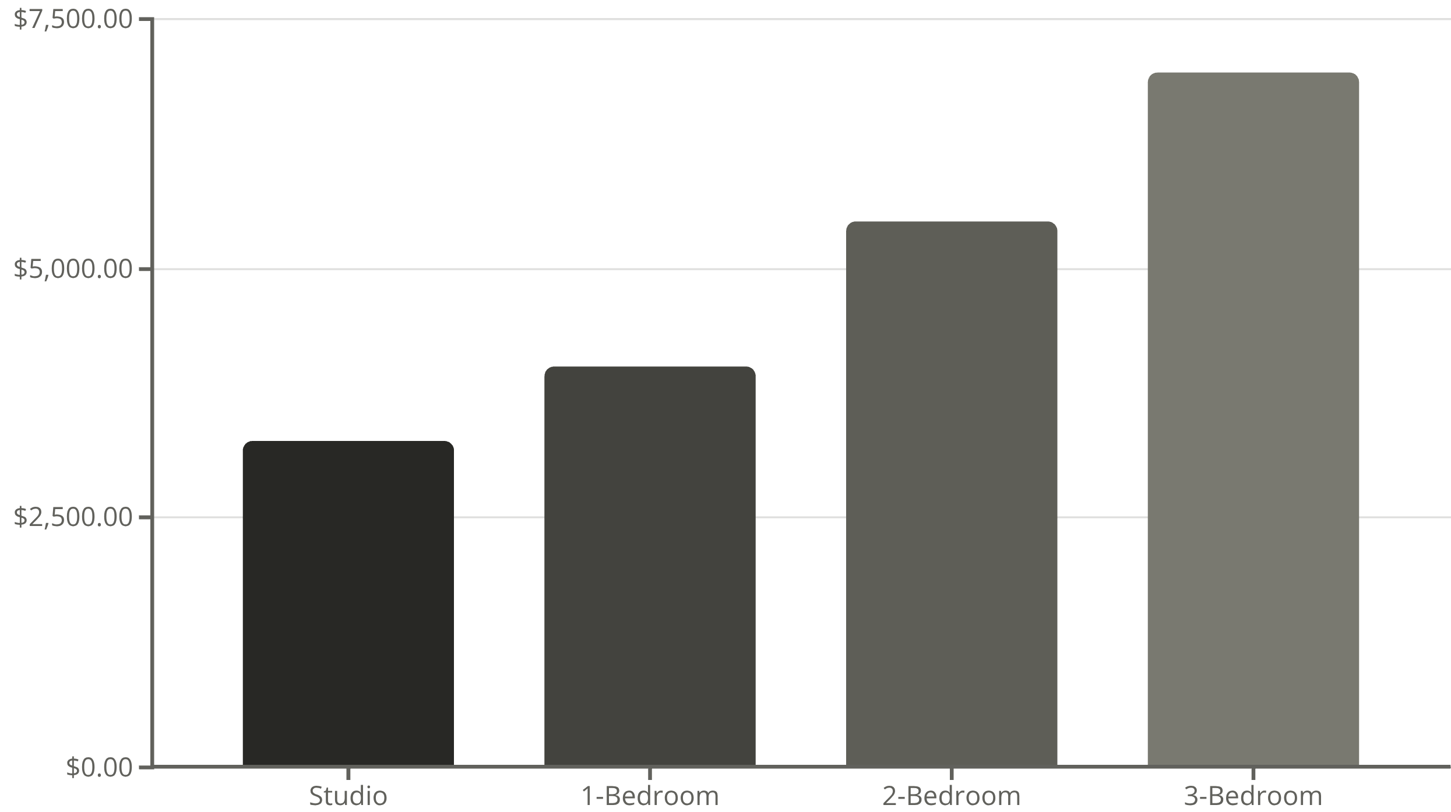
Average Monthly Rent by Apartment Size
Under $2,000/month
Direct subway access to Times Square-42nd Street for work commute
Year-over-year increase
Above national average
Astoria Blvd station area offers an attractive blend of affordability and urban convenience for renters seeking a vibrant Queens lifestyle under $2,000/month. This bustling neighborhood boasts an exceptional Greek and Mediterranean food scene, with authentic tavernas and cafes dotting the streets alongside diverse international eateries. The N/W subway lines provide swift access to Manhattan, typically reaching Midtown in under 25 minutes. Young professionals and food enthusiasts appreciate the area's mix of traditional charm and modern amenities, from cozy walk-ups to renovated pre-war buildings. The neighborhood's pedestrian-friendly streets, abundant nightlife options, and proximity to Astoria Park make it an ideal

